Slide 1
introduction to Linear programming
BIT UCU 2107

Slide 2
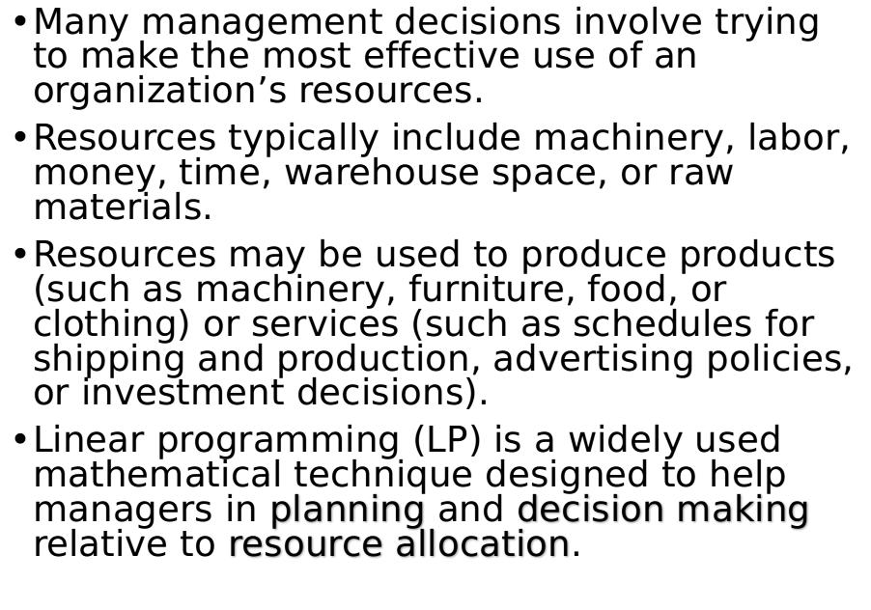
Introduction

Slide 3
Despite the name, linear programming, and the more general category of techniques called “mathematical programming”, have very little to do with computer programming.
In the world of Operations Research, programming refers to modeling and solving a problem mathematically.
Computer programming has, however, played an important role in the advancement and use of LP to solve real-life LP problems

Slide 4
Example: Giapetto woodcarving,
Giapetto Woodcarvin, manufactures two types of wooden toys: soldiers and trains.
A soldier sells for $27 and uses $10 worth of raw materials.
Each soldier that is manufactured increases Giapetto’s variable labor and overhead cost by $14.

Slide 5
Example: Giapetto woodcarving,
A train sells for $21 and uses $9 worth of raw materials. Each train built increases Giapetto’s variable labor and overhead cost by $10.
The manufacture of wooden soldiers and trains requires two types of skilled labor: carpentry and finishing.
A soldier requires 2 hours of finishing labor and 1 hour of carpentry labor. A train requires 1 hour of finishing and 1 hour of carpentry labor.

Slide 6
Example: Giapetto woodcarving,
Each week, Giapetto can obtain all the needed raw material but only 100 finishing hours and 80 carpentry hours. Demand for trains is unlimited, but at most 40 soldiers are bought each week. Giapetto wants to maximize weekly profit. Formulate a linear programming model of Giapetto’s situation that can be used to maximize Giapetto’s weekly profit

Slide 7
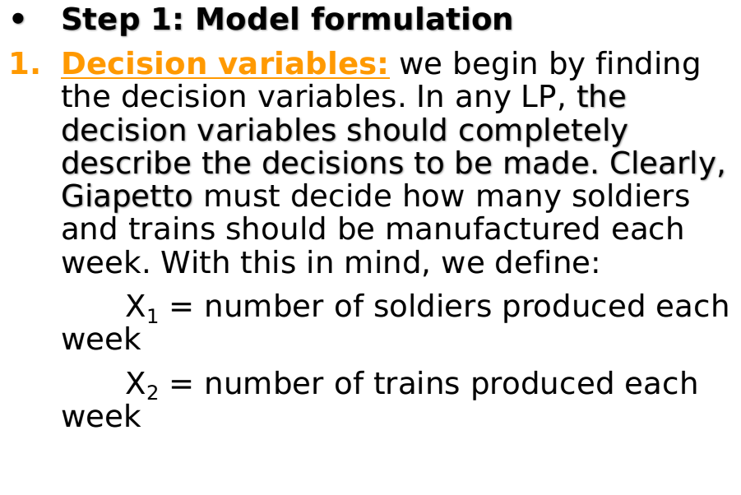
Solution: Giapetto woodcarving Inc.,

Slide 8
Solution: Giapetto woodcarving,
2. Objective function: in any LP, the decision maker wants to maximize (usually revenue or profit) or minimize (usually costs) some function of the decision variables.
The function to be maximized or minimized is called the objective function.
For the Giapetto problem, we will maximize the net profit (weekly revenues – raw materials cost – labor and overhead costs).
Weekly revenues and costs can be expressed in terms of the decision variables, X₁ and X₂ as following:

Slide 9
Solution: Giapetto woodcarving ,
Weekly revenues = weekly revenues from soldiers + weekly revenues from trains
= 27 X₁ + 21 X₂
Also,
Weekly raw materials costs = 10 X₁ + 9 X₂
Other weekly variable costs = 14 X₁ + 10 X₂
Therefore, the Giapetto wants to maximize:
(27 X₁ + 21 X₂) – (10 X₁ + 9 X₂) – (14 X₁ + 10 X₂) = 3 X₁ + 2 X₂
Hence, the objective function is:
Maximize Z = 3 X₁ + 2 X₂

Slide 10
Solution: Giapetto woodcarving,
3. Constraints:
as X₁ and X₂ increase, Giapetto’s objective function grows larger.
This means that if Giapetto were free to choose any values of X₁ and X₂, the company could make an arbitrarily large profit by choosing X₁ and X₂ to be very large.
Unfortunately, the values of X₁ and X₂ are limited by the following three restrictions (often called constraints):

Slide 11
Constraints
Constraint 1: each week, no more than 100 hours of finishing time may be used.
Constraint 2: each week, no more than 80 hours of carpentry time may be used.
Constraint 3: because of limited demand, at most 40 soldiers should be produced.

Slide 12
Solution: Giapetto woodcarving,
The three constraints can be expressed in terms of the decision variables X₁ and X₂ as follows:
Constraint 1: 2 X₁ + X₂ <= 10
Constraint 2: X₁ + X₂ <= 80
Constraint 3: X₁ <= 40

Slide 13
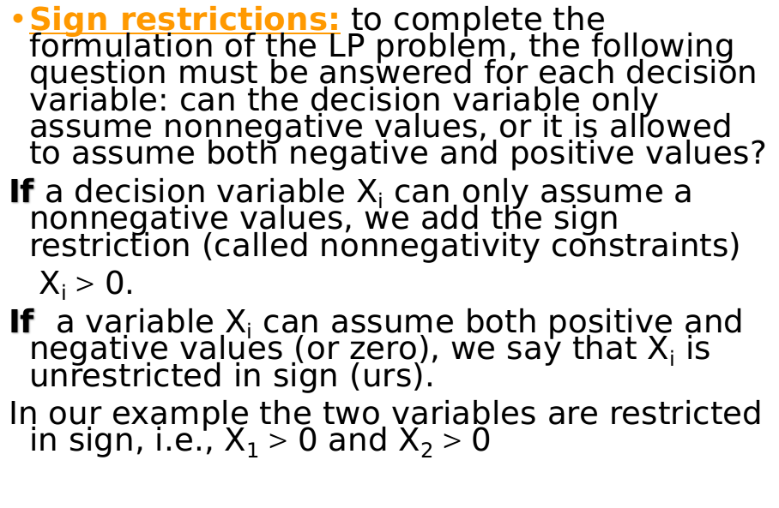
Solution: Giapetto woodcarving,

Slide 14
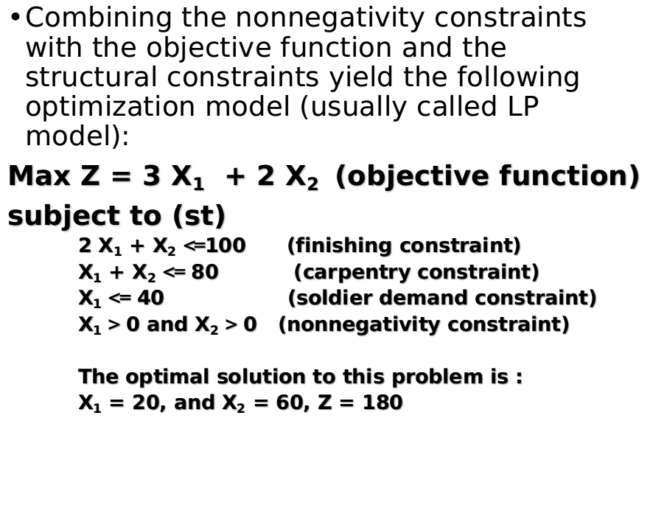
Solution: Giapetto woodcarving,

Slide 15
What is a Linear programming problem (LP)?
LP is an optimization problem for which we do the following:
1. We attempt to maximize (or minimize) a linear function of the decision variables. The function that is to be maximized or minimized is called objective function.
2. The values of decision variables must satisfy a set of constraints. Each constraint must be a linear equation or linear inequality.
3. A sign restriction is associated with each variable. for any variable X_{i}, the sign restriction specifies either that X_{i} must be nonnegative (X_{i} > 0) or that X_{i} may be unrestricted in sign.

Slide 16
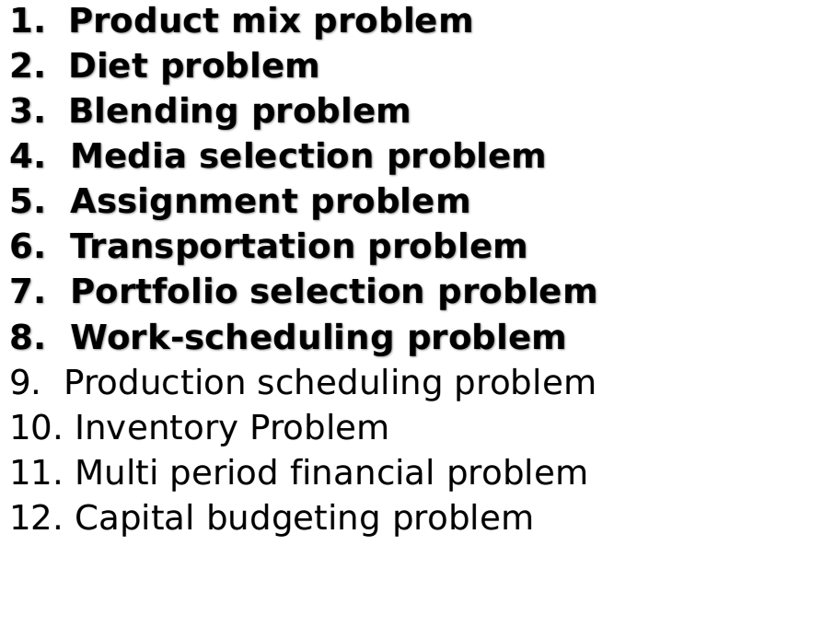
Applications Of LP

Slide 17
Spreadsheet Elements
The common elements in all LP spreadsheet model are the following:
  Inputs. All numerical inputs - that is, the data needed to form the objective and the constraints - must appear somewhere in the spreadsheet. It is not necessary but it often helps to enclose inputs in a blue border with shading.
  Changing cells. Instead of using variable names, such as x’s, there is a set of designated cells that play the role of the decision variables. These values in these cells can be changed to optimize the objective. In Excel these cells are called the changing cells. To designate these we often enclose them in a red border.

Slide 18
Spreadsheet Elements -- continued
  Target (objective) cell. One cell, called the target cell or the objective cell, contains the value of the objective. Solver systematically varies the values in the changing cells to optimize the value in the target cell. Our convention is to enclose the target cell within a black double line border.
  Constraints. Excel does not show the constraints directly on the spreadsheet. Instead we specify constraints in a Solver dialog box.
  Nonnegativity. Normally we want the decision variables - that is, the values in the changing cells - to be nonnegative. For certain versions of Excel these nonnegativity constraints might need to be specified explicitly.

